Slide 1
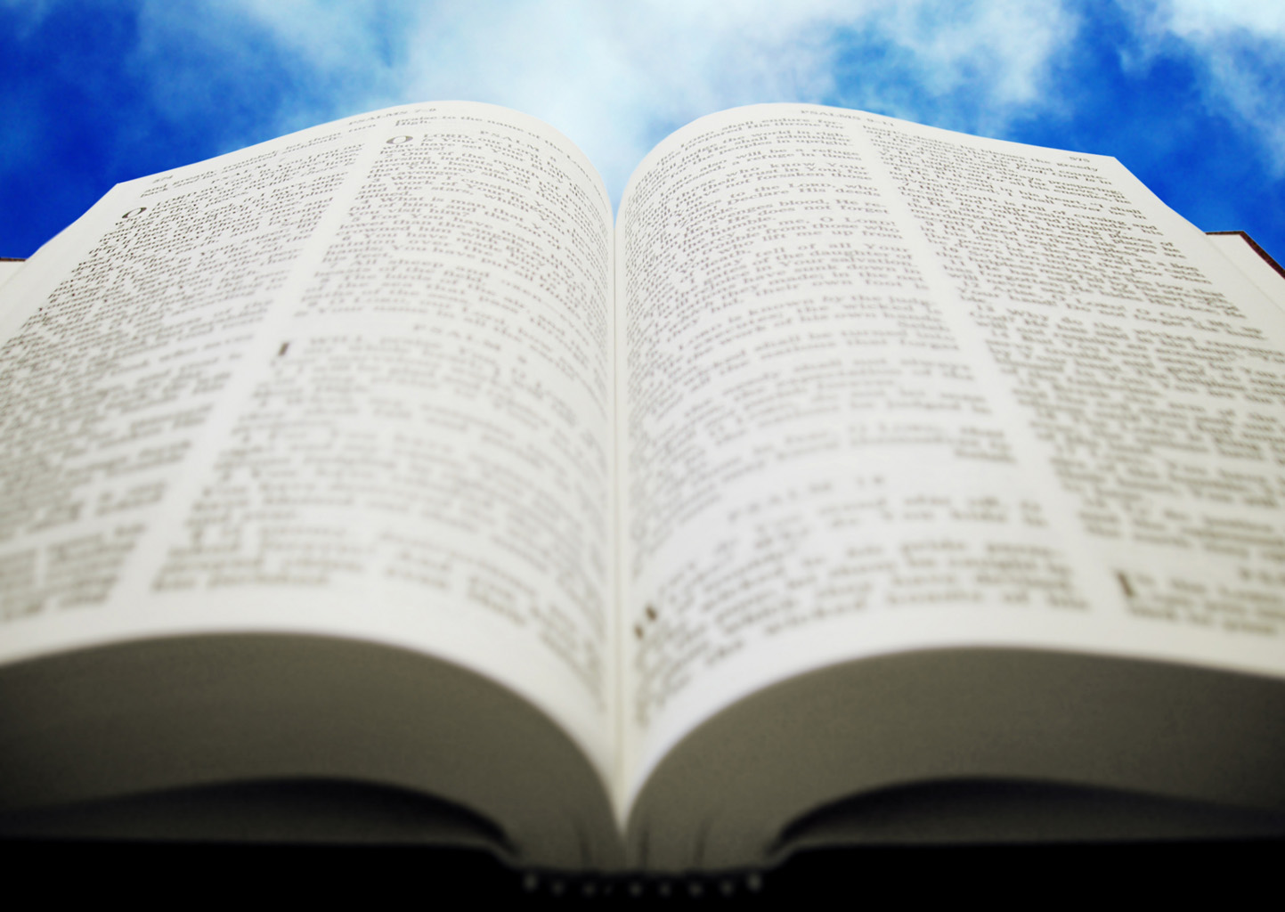
Welcome!
Sunday
Worship 10:00 AM
Sunday
Bible Class (Livestream) 5:00 PM
Wednesday
Bible Class 7:00 PM
www.SunsetchurchofChrist.net

Slide 2
Opening Prayer | Terry Petsche
Song – | George Watkins
Song – | George Watkins
Lord’s Supper | Ryan Sollars
Song – | George Watkins
Song – | George Watkins
Lesson | Brian Haines
Song – | George Watkins
Closing | Anthony Ward
1 Corinthians 16:2
On the first day of the week let each one of you lay something aside, storing up as he may prosper, that there be no collections when I come.
A collection basket
is in the foyer

Slide 3
Healthy Skepticism

Slide 4
Skepticism and Faith
Skeptic (in common usage)
One who doubts God’s existence
One who denies absolute truth

Slide 5
Skepticism and Faith
Most “skeptics” are NOT skeptical….
They accept much without question
Their skepticism is actually disbelief

Slide 6
Skepticism and Faith
Most “skeptics” are NOT skeptical….
True skepticism examines all things

Slide 7
Skepticism and Faith
Test all things; hold fast what is good. Abstain from every form of evil. 1 Thessalonians 5:21-22
God desires we have healthy skepticism

Slide 8
Divine Desire for Skepticism
Thomas’ doubt – John 20:24-29
Thomas asked for a sign
Jesus gave him his sign
Thomas believed
Notes:
Joh 20:24 Now Thomas, called the Twin, one of the twelve, was not with them when Jesus came. 25 The other disciples therefore said to him, "We have seen the Lord." So he said to them, "Unless I see in His hands the print of the nails, and put my finger into the print of the nails, and put my hand into His side, I will not believe." 26 ¶ And after eight days His disciples were again inside, and Thomas with them. Jesus came, the doors being shut, and stood in the midst, and said, "Peace to you!" 27 Then He said to Thomas, "Reach your finger here, and look at My hands; and reach your hand here, and put it into My side. Do not be unbelieving, but believing." 28 And Thomas answered and said to Him, "My Lord and my God!" 29 Jesus said to him, "Thomas, because you have seen Me, you have believed. Blessed are those who have not seen and yet have believed."

Slide 9
Divine Desire for Skepticism
Thomas’ doubt – John 20:24-29
Ahaz’ test – Isaiah 7:10-13
God asked Ahaz to test Him
Ahaz refused
God disapproved of Ahaz
Notes:
Isa 7:10 ¶ Moreover the LORD spoke again to Ahaz, saying, 11 "Ask a sign for yourself from the LORD your God; ask it either in the depth or in the height above." 12 But Ahaz said, "I will not ask, nor will I test the LORD!" 13 Then he said, "Hear now, O house of David! Is it a small thing for you to weary men, but will you weary my God also?

Slide 10
Divine Desire for Skepticism
Thomas’ doubt – John 20:24-29
Ahaz’ test – Isaiah 7:10-13
The Berean search – Acts 17:10-12
Listened to Paul
Tested his words
Believed when confirmed
Notes:
Ac 17:10 ¶ Then the brethren immediately sent Paul and Silas away by night to Berea. When they arrived, they went into the synagogue of the Jews. 11 These were more fair-minded than those in Thessalonica, in that they received the word with all readiness, and searched the Scriptures daily to find out whether these things were so. 12 Therefore many of them believed, and also not a few of the Greeks, prominent women as well as men.

Slide 11
Divine Desire for Skepticism
God’s desire:
(1) Test all things
(2) Hold fast what is good.
(3) Abstain from every form of evil
How do we apply healthy skepticism?

Slide 12
Test ALL Things
Putting all things to the test
Beloved, do not believe every spirit, but test the spirits to see whether they are from God; because many false prophets have gone out into the world. 1 John 4:1
Notes:
Mt 18:16 "But if he will not hear, take with you one or two more, that 'by the mouth of two or three witnesses every word may be established.‘
2Co 13:1 ¶ This will be the third time I am coming to you. "By the mouth of two or three witnesses every word shall be established."

Slide 13
Test ALL Things
Making requirements to believe
“By the mouth of 2 or 3 witnesses”
“By their fruits you will know them”
“Searching the Scriptures”
Notes:
Mt 18:16 "But if he will not hear, take with you one or two more, that 'by the mouth of two or three witnesses every word may be established.‘
2Co 13:1 ¶ This will be the third time I am coming to you. "By the mouth of two or three witnesses every word shall be established."

Slide 14
Hold Fast to What is Good
Accepting what passes the test
2 Corinthians 13:5-6
Acceptance often means change
Notes:
2Co 13:5 Examine yourselves as to whether you are in the faith. Test yourselves. Do you not know yourselves, that Jesus Christ is in you? --unless indeed you are disqualified. 6 But I trust that you will know that we are not disqualified.

Slide 15
Reject What is Evil
And have no fellowship with the unfruitful works of darkness, but rather expose them. Ephesians 5:11
Notes:
2Co 13:5 Examine yourselves as to whether you are in the faith. Test yourselves. Do you not know yourselves, that Jesus Christ is in you? --unless indeed you are disqualified. 6 But I trust that you will know that we are not disqualified.

Slide 16
Reject What is Evil
And have no fellowship with the unfruitful works of darkness, but rather expose them. Ephesians 5:11

Slide 17
Unhealthy Skepticism
Believing/disbelieving based on desire
“I want it to be true”
“I don’t want it to be true”

Slide 18
Unhealthy Skepticism
Believing/disbelieving based on desire
Belief without question
Accepting what we are told
Blind faith

Slide 19
Unhealthy Skepticism
Believing/disbelieving based on desire
Belief without question
Refusing to believe when verified

Slide 20
God Desires Inquiring Minds
"And He has made from one blood every nation of men to dwell on all the face of the earth, and has determined their preappointed times and the boundaries of their dwellings, so that they should seek the Lord, in the hope that they might grope for Him and find Him, though He is not far from each one of us”
Acts 17:26-27

Slide 21
God Desires Inquiring Minds
God created us to seek:
Him
His kingdom
His righteousness
To discern we must test all things

Slide 23
Having Tested the Truth
What do you need to do next?
Obey the Gospel
Hearing and believing
Confessing Christ as Lord
Being Baptized
Grow in faith

